Slide 1
Make my trip dataset analysis
Presented by: Shubham Upadhyay
Project file: MAKE MY TRIP DATASET ANLAYSIS.ipynb - Colab
Dataset: Hotels on Makemytrip

Slide 2
Introduction
This dataset is a sample from Make My Trip, providing information on approximately 20,000 hotels. Comprising around 33 columns, it includes various attributes such as hotel names, locations, amenities, ratings, and availability, making it a useful resource for analysing hotel trends.

Slide 3
Objective
Download the CSV file from the website and upload it to Google Colab. Begin the data cleaning process by removing any unnecessary columns in the file. Next, identify any null values and address them appropriately. Check for outliers in the data set. Finally, analyze the dataset to extract key findings and create visual charts to represent your analysis.

Slide 4
Key Questions
1. Find Out The Top 5 City, Area And State
2. Find Out The Top 10 Busiest Month For Queries
3. Discover The Average Food Rating Across Top 10 City
4. Discover The Average Value For Money Rating Across Top 10 City
5. Analyse The Average Experience Of Visitors Across Top 10 City
6. Find Out The Distribution Of Special Added Values
7. Analyse The Average Approval Rating Based On Area, city And State
$3,000
Jupiter is the biggest planet in the entire Solar System

Slide 5
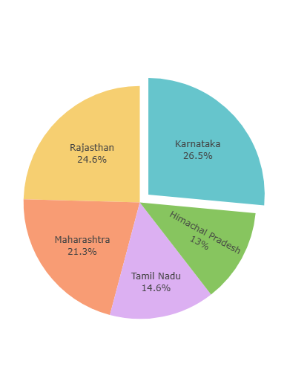
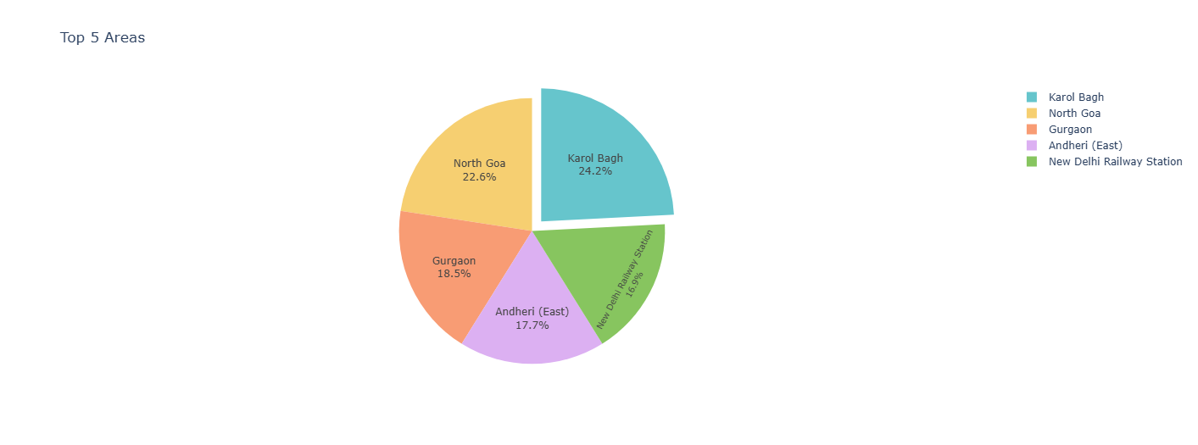
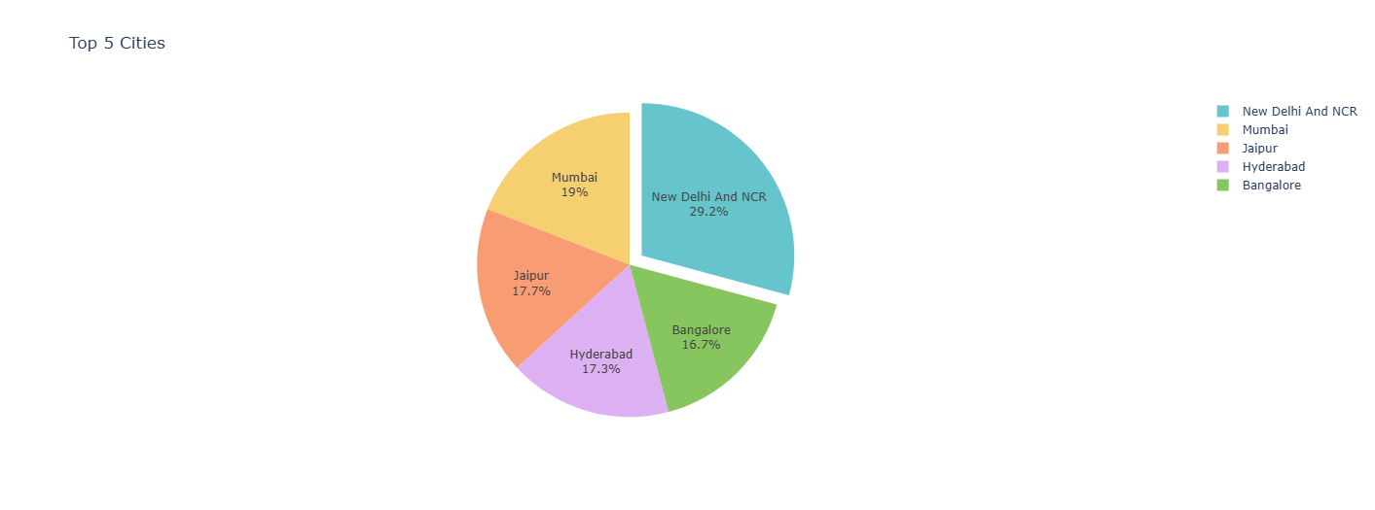
Top 5 City, Area And State
These pie charts represent three different parameters.
State:
Rajasthan has the largest share with 24.6%.
Karnataka follows closely with 26.5%.
North Goa, Maharashtra, and Tamil Nadu have smaller shares, ranging from 13% to 22.6%.
Area:
New Delhi and NCR have the largest area with 29.2%.
Jaipur and Mumbai follow with 17.7% and 19% respectively.
Karol Bagh and Andheri (East) have smaller areas, ranging from 17.3% to 18.5%.
City:
* Bangalore has the largest share with 16.7%.
Hyderabad follows with 17.3%.
Gurgaon, Andheri (East), and Jaipur have smaller shares, ranging from 16.9% to 18.5%.
State
Area
city

Slide 6
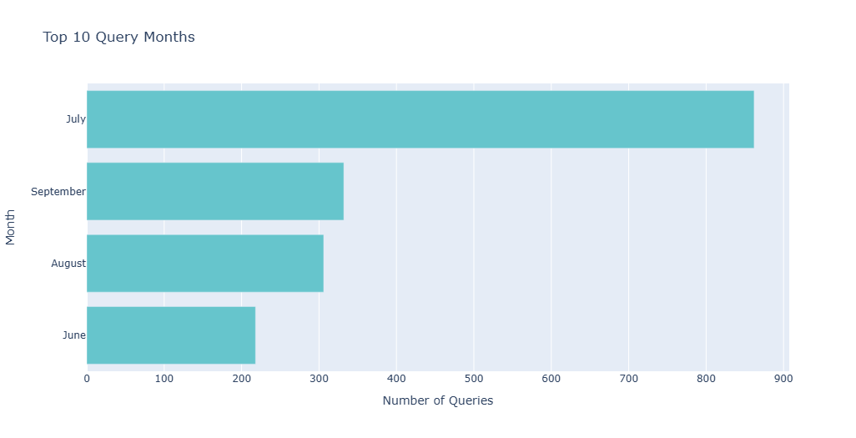
Top 10 Busiest Month For Queries
Key Observations:
July is the busiest month with the highest number of queries.
September and August follow July with a significant number of queries.
The other months have a lower number of queries compared to the top three.
The chart clearly shows a trend where July, September, and August are the peak months for queries.

Slide 7
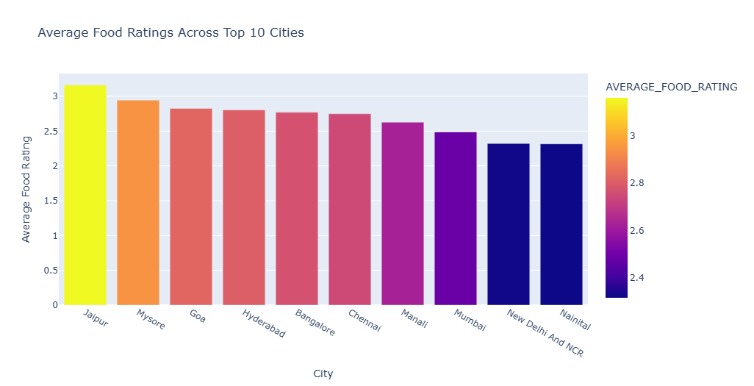
The Average Food Rating Across Top 10 City
Key Observations:
Jaipur has the highest average food rating.
Mysore and Goa follow Jaipur with high average ratings.
New Delhi and NCR have the lowest average food rating among the top 10 cities.
The chart clearly shows a trend where Jaipur, Mysore, and Goa have the highest average food ratings.

Slide 8
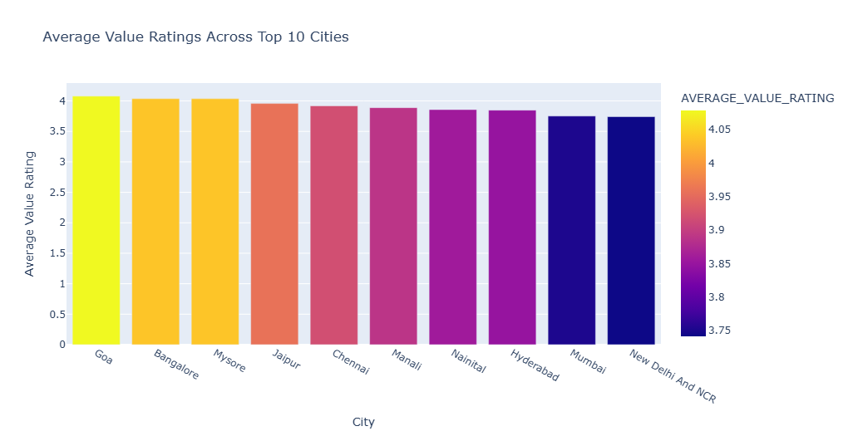
Average Value For Money Rating Across Top 10 City
Key Observations:
Goa has the highest average value for money rating.
Bangalore and Mysore follow Goa with high average ratings.
New Delhi and NCR have the lowest average value for money rating among the top 10 cities.
The chart clearly shows a trend where Goa, Bangalore, and Mysore have the highest average value-for-money ratings.

Slide 9
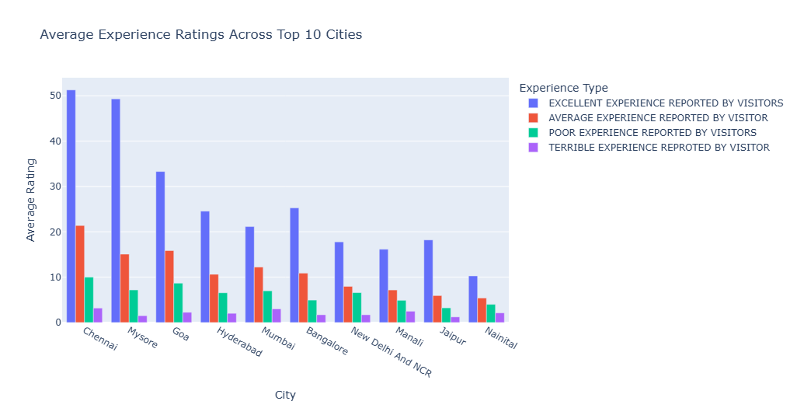
Average Experience Of Visitors Across Top 10 City
Key Observations:
Chennai has the highest percentage of visitors reporting an "Excellent" experience.
Jaipur and Mysore also have a high percentage of visitors reporting an "Excellent" experience.
New Delhi and NCR have the lowest percentage of visitors reporting an "Excellent" experience and the highest percentage of visitors reporting a "Poor" or "Terrible" experience.
The chart clearly shows a trend where Chennai, Jaipur, and Mysore have the highest percentage of visitors reporting an "Excellent" experience.

Slide 10
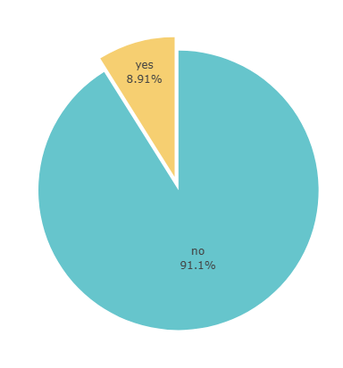
Distribution Of Special Added Values
Key Observation:
* The majority, 91.1%, falls under the category of "no." This suggests that a large portion of the data set does not have the special added values.
* Only a small percentage, 8.91%, falls under the category of "yes”.
This indicates that a limited number of data points possess the special added values.

Slide 11
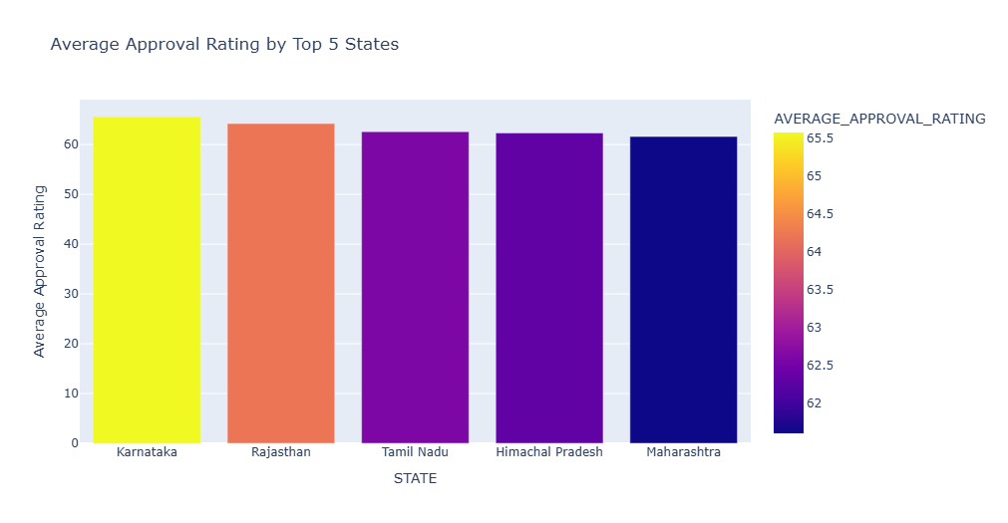
The Average Approval Rating Based On State
Key Observations:
Karnataka has the highest average approval rating.
Rajasthan and Tamil Nadu follow Karnataka with high average ratings.
Himachal Pradesh and Maharashtra have lower average approval ratings compared to the top three states.
The chart clearly shows a trend where Karnataka, Rajasthan, and Tamil Nadu have the highest average approval ratings.

Slide 12
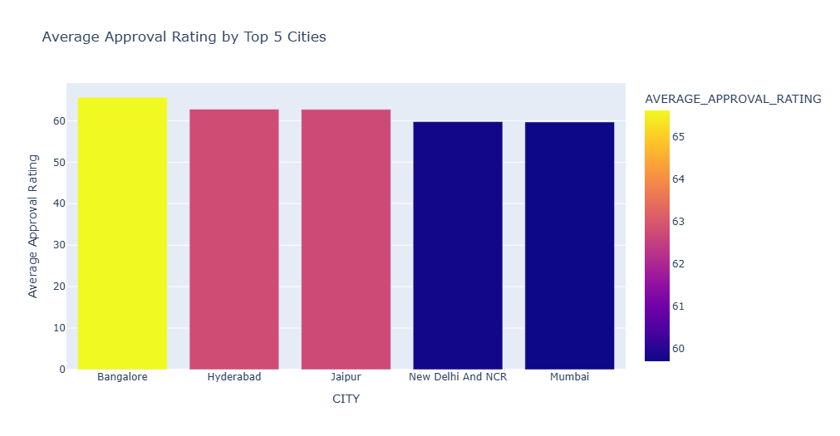
The Average Approval Rating Based On city
Key Observations:
Bangalore has the highest average approval rating. * Hyderabad and Jaipur follow Bangalore with high average ratings.
New Delhi and NCR have the lowest average approval rating among the top 5 cities.
The chart clearly shows a trend where Bangalore, Hyderabad, and Jaipur have the highest average approval ratings.

Slide 13
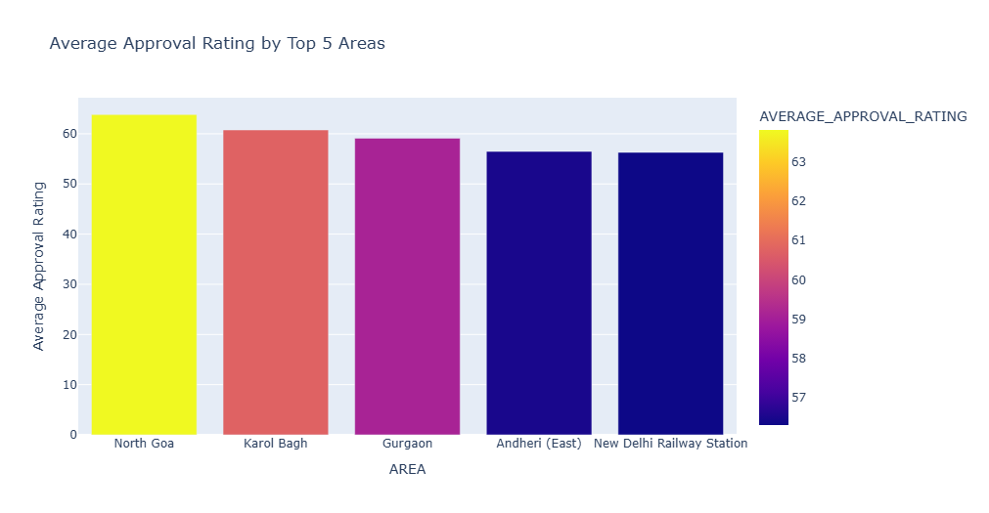
The Average Approval Rating Based On Area
Key Observations:
North Goa has the highest average approval rating.
Karol Bagh and Gurgaon follow North Goa with high average ratings.
Andheri (East) and New Delhi Railway Station have lower average approval ratings compared to the top three areas.
The chart clearly shows a trend where North Goa, Karol Bagh, and Gurgaon have the highest average approval ratings.

Slide 14
conclusion
Conducted analysis of the entire dataset and created clear visualisations to represent the findings effectively. Focus on generating relevant charts and graphs that illustrate the responses in a meaningful way, helping to highlight key trends and insights.

Slide 15
THE END

